Slide 1

Chapter - 5
POLLUTION CONTROL AND DISASTER MANAGEMENT

Slide 2
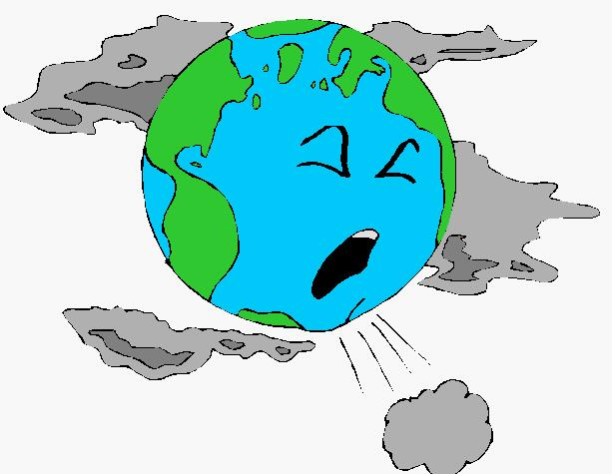
Environmental Pollution
The word ‘pollution’ is derived from the Latin word ‘polluere’ which means ‘to soil or defile’ .
Any alteration to air, water, soil or food that threatens the health, survival capability or activities of humans or other living organisms is called environmental pollution.

Slide 3
Types of Environmental pollution
Air Pollution
Water Pollution
Noise Pollution
Soil Pollution
Marine pollution
Thermal pollution
Radiation Pollution
Solid waste Pollution

Slide 4
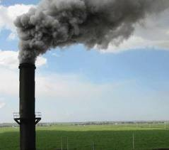
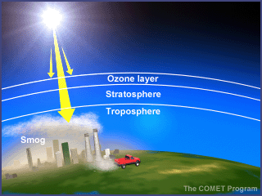
Air Pollution
Air pollution is the introduction into the atmosphere of chemicals, particulates, or biological materials that cause discomfort, disease, or death to humans, damage other living organisms such as food crops, or damage the natural environment or built environment

Slide 5
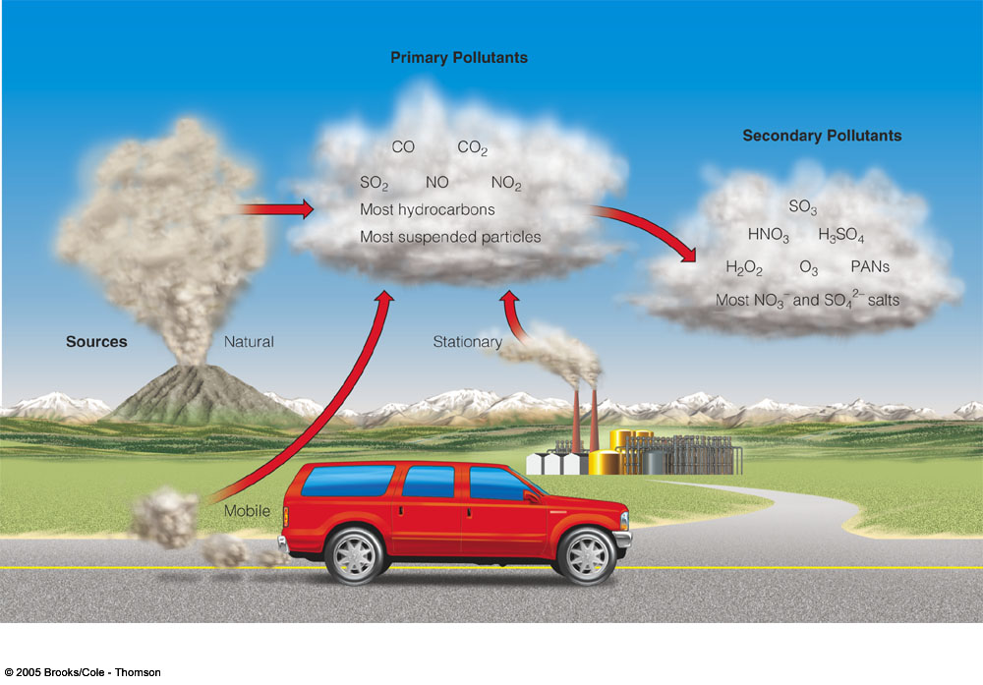
  Pollutants
  Primary pollutants are the pollutants, which are emitted
  directly from identifiable sources.
  Secondary pollutants, are those which are produced in the atmosphere when certain chemical reactions take place among primary pollutants.

Slide 6
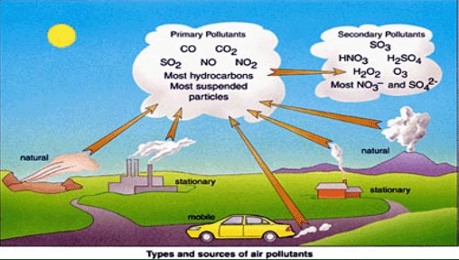
Primary Pollutants
Particulate matter (PM),
  Sulfur dioxide,
  Nitrogen oxides,
  Volatile organic
  compounds (VOCs),
  Carbon monoxide, Lead, Ozone
  .
  Secondary Pollutants
Atmospheric sulfuric acid
Photochemical smog
Ozone

Slide 7
Main Sources of Air Pollution

Slide 8
Major Pollutants:
1.) Carbon Monoxide and Carbon Dioxide
2.) Sulfur Dioxide
3.) Nitrogen Dioxide
4.) Particulate Matter
5.) Ground Level Ozone
6.) Hydrocarbons
7. )Chloroflourocarbons (CFC)
8.) Suspended particulate matter (SPM)

Slide 9


Carbon Monoxide
colorless, odorless
produced when carbon does not burn completely in fossil fuels
present in car exhaust
deprives body of O2 causing headaches, fatigue,
and impaired vision
Carbon Dioxide:
It is chief green house gas released in the atmosphere as a result of human activities such as burning of coal, oil and natural gas.

Slide 10

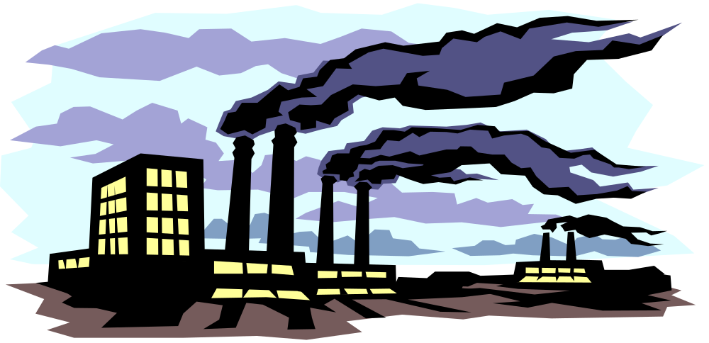
Sulfur Dioxide
produced when coal and fuel oil are burned
present mainly in thermal power plants, production of paper, melting of metals.
narrows the airway, causing wheezing and shortness of breath, especially in those with asthma
Major contributor to smog and acid rain.

Slide 11
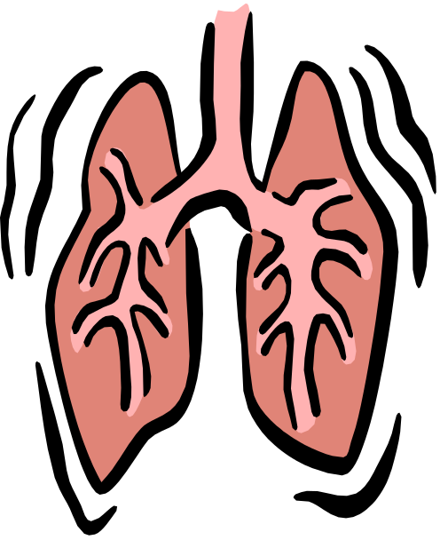
Nitrogen Dioxide
reddish, brown gas
produced when nitric oxide combines with oxygen in the atmosphere
Form by burning of fuel, petrol, diesel and coal.
present in car exhaust and power plants.
affects lungs and causes wheezing; increases chance of respiratory infection
contributor to smog and acid rain.

Slide 12


Particulate Matter/atmospheric
aerosol
particles of different sizes and structures that are released into the atmosphere
present in many sources including fossil fuels, dust, smoke, fog, etc.
can build up in respiratory system
aggravates heart and lung disease; increases risk of respiratory infection

Slide 13
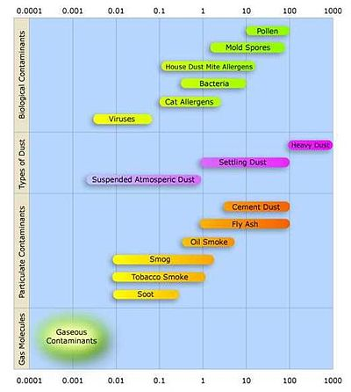
This diagram shows the size distribution in micrometres of various types of atmospheric particulate matter. It also shows the different types of particulates in the atmosphere

Slide 14
Hydrocarbons
Vehicles, industries and refineries are the source of these.
Irritation in respiratory system and leads to lung cancer
Chlorofluorocarbons
These are the gases released from AC’s and other refrigeration systems. These rise to atmosphere and destroys the ozone layer

Slide 15

Ground Level Ozone
at upper level, ozone shields Earth from sun’s harmful UV rays
at ground level, ozone is harmful pollutants
formed from car, power and chemical plant exhaust
irritate respiratory system and asthma; reduces lung function by inflaming and damaging lining of lungs

Slide 16
Causes of air pollution
Natural causes
Man-made causes
Industrial Emissions
Automobiles
Thermal power stations
Nuclear explosions
Nuclear power plants
Agricultural activities
Disposal of garbage
Dust storms
Volcanoes
Forest fires

Slide 17
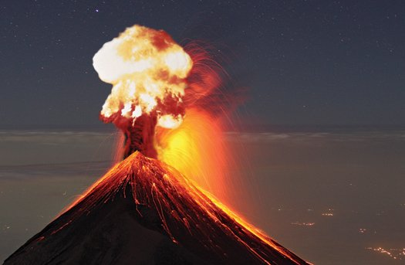
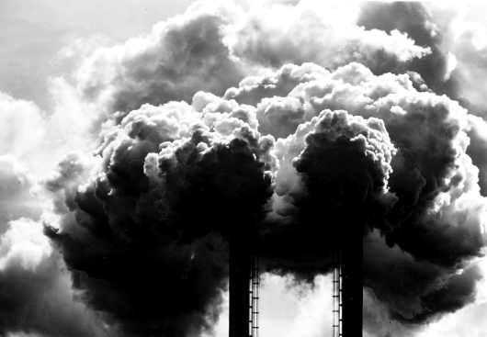

Natural Causes:
Natural disasters such as cyclone, volcanic eruptions and earthquakes cause suspension of dust particles and ash in air and cause air pollution. Air pollution may also be caused by other natural factors such as forest fires, pollen grains, microbes etc.
Methane gas is released in natural gas fields due to decay of organic matter.
Randon gas is released due to radioactive decay with in the earth’s crust .
Smoke and carbon monoxide are emitted during forest fires.

Slide 18
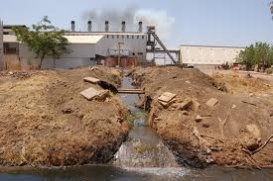
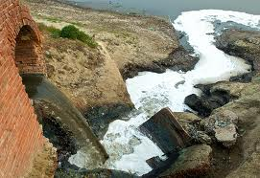
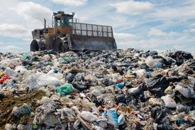
Man made causes:
Industrial Wastes: The increasing number of industries contribute heavily to air pollution. Different industries produce air pollution in different manners depending on the processes involved. Petroleum refineries emit large amount of hydrocarbons and particulate matter and industries such as iron and steel mills , paper mills , chemical plants and cement plants release vast amounts of different types of particulates into the atmosphere.

Slide 19
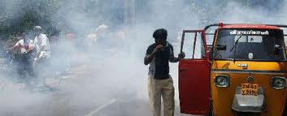
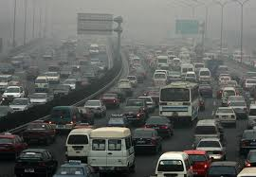
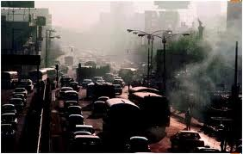
AUTOMOBILES
Due to increase in population the number of automobiles on the roads are increased. These make transportation easy and convenient, but also emit dangerous pollutants such as carbon dioxide , sulphur dioxide,nitrogen oxides, hydrocarbons, ozone, lead and chlorofluorocarbons. These lead to variety of respiratory problems and serious ailments in human beings and other living creatures.

Slide 20
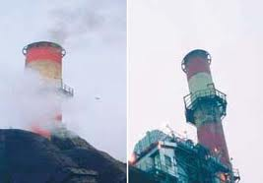
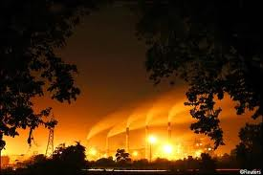
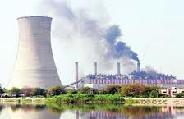
Thermal Power Stations:
To meet the need of electricity a large number of thermal power stations have been set up. Most of them use coal as main fuel and coal ash is generated as product. Due to lack of disposal system of this coal ash leads to adverse environment effect. Other pollutants generated are fly ash, sulphur dioxide and other gases which are harmful to us.

Slide 21
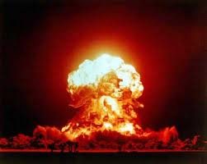
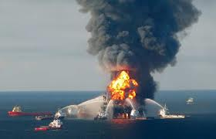
Nuclear explosions:
Nuclear explosions release huge amounts of pollutants including many hazardous chemicals and dust particles into the atmosphere. Huge amounts of radioactive material with long life times cause huge effects on human health.

Slide 22
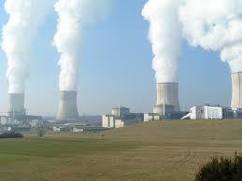
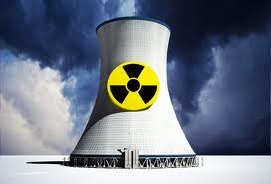
Nuclear Power Plants
These plants damage the environment owing to uranium mining , radioactive effluent emission and generation of waste heat. However the damage caused by nuclear power plant are less than those from fossil fuel plants. An average coal plant kills 25 people per year while pollution from similar nuclear plant kills 0.018 people.

Slide 23
Agricultural activities:
The excessive use of fertilizers ad pesticides for increasing productivity leads to severe environmental damage. These chemicals cause air pollution when sprayed and travel through air and hence cause air pollution. It has been found that only 10-15% of the substances reach to the source and rest of the chemical are blown to about 20 miles. Other agriculture based industries like sugar mills, oil mills and crop –residue burning, cotton mills, seed cleaning, etc.
Disposal of garbage: All types of biodegradable and non biodegradable waste materials produce smoke and soot when burnt hence cause air pollution. Burning of waste material is an unhealthy mode of garbage disposal since it releases toxic fumes into the atmosphere which may adversely effect health of living being.

Slide 24
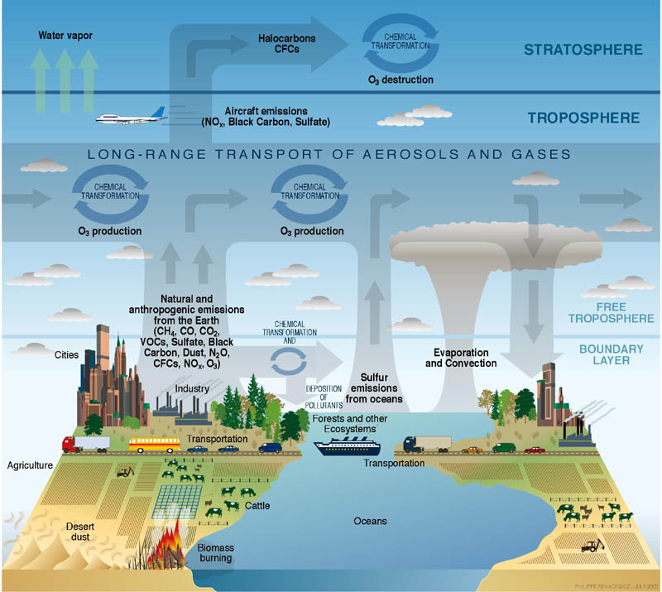
Many processes contribute to atmospheric pollution and trace gases.

Slide 25

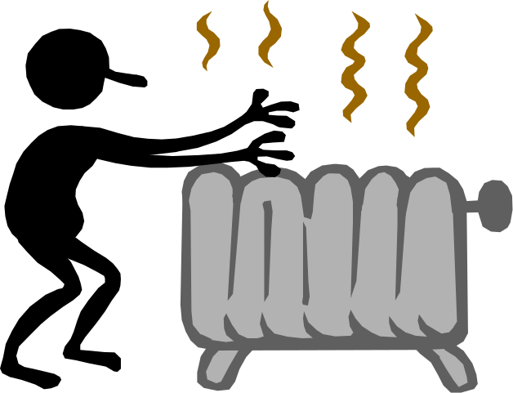

Indoor Air Pollution

Slide 26
What Causes Indoor Air Pollution??
· Air tightness of buildings
· Poorly designed air conditioning and ventilation systems
· Indoor sources of pollution
· Outdoor sources of pollution

Slide 27
What Causes Indoor Air Pollution??
Poorly Designed Air Conditioning Systems Results into the production of fungi, molds and other sickness causing microbes.
Problems of IAQ Enclosed spaces inhabited by humans produce following effects-
· Reduction in oxygen level of spaces.
· Increase in CO2 level.
· Increase in temperature.
· Increase in humidity
· Increase in Bioaerosols and odor

Slide 28
Main indoor pollutants and their sources
Main indoor air pollutant and their sources
Pollutant | Sources
Environmental tobacco smoke | Cigarette and water pipe smoking
Carbon monoxide | Unburned kerosene, gas water heaters, gas stoves, automobile exhaust, tobacco smoke
Lead | Lead based paints, contaminated soil, dust and drinking water
Asbestos | Deteriorating, damaged, or disturbed insulation, fireproofing, acoustical materials, and floor tiles

Slide 29
Main indoor air pollutant and their sources
NO2 | Kerosene heaters, un-vented gas stoves and heaters. Environmental tobacco smoke
Formaldehyde | Furniture made with pressed wood products, urea-formaldehyde foam insulation, environmental tobacco smoke, glues
Volatile organic compounds | Paint, paint stripper, solvent aerosol sprays
Respirable particles | Kerosene heaters, wood stoves, fireplaces, environmental tobacco smoke
Biological pollutants | Dust mite, Pet dander, droppings and body parts of cockroaches rodents and other pests
Radon | Building materials and well water

Slide 30

What Can You Do?
Indoor Air Pollution
• Test for radon and formaldehyde inside your home and take corrective measures as needed.
• Do not buy furniture and other products containing formaldehyde.
• Remove your shoes before entering your house to reduce inputs of dust, lead, and pesticides.
• Test your house or workplace for asbestos fiber levels and for any crumbling asbestos materials if it was built before 1980.
• Don't live in a pre-1980 house without having its indoor air tested for asbestos and lead.
• Do not store gasoline, solvents, or other volatile hazardous chemicals inside a home or attached garage.
• If you smoke, do it outside or in a closed room vented to the outside.
• Make sure that wood-burning stoves, fireplaces, and kerosene- and gas-burning heaters are properly installed, vented, and maintained.
• Install carbon monoxide detectors in all sleeping areas.
Notes:
Figure 19.21
Individuals matter: ways to reduce your exposure to indoor air pollution. QUESTION: Which three of these actions do you think are the most important?

Slide 31
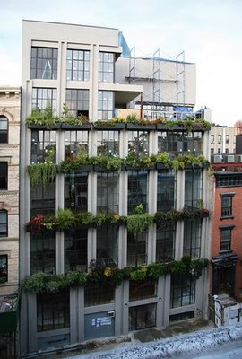

Slide 32

AQI: Air Quality Index (National Air quality standard)
Environmental protection agency (EPA) calculate AQI for 5 major air pollutants (ground level ozone, partiulate matter, CO, SO2, NO2).
Indicates whether pollutant levels in air may cause health risks.
Ranges from 0 (least concern) to 500 ppm (greatest concern)
AQI value above 100 indicate unhealthy air quality.

Slide 33
Air Quality | Air Quality Index | Protect Your Health
Good | 0-50 | No health impacts are expected when air quality is in this range.
Moderate | 51-100 | Unusually sensitive people should consider limiting prolonged outdoor exertion.
Unhealthy for Sensitive Groups | 101-150 | Active children and adults, and people with respiratory disease, such as asthma, should limit prolonged outdoor exertion.
Unhealthy | 151-200 | Active children and adults, and people with respiratory disease, such as asthma, should limit prolonged outdoor exertion, everyone else, especially children should limit prolonged outdoor excertion.
Very Unhealthy (Alert) | 201-300 | Active children and adults, and people with respiratory disease, such as asthma, should limit prolonged outdoor exertion everyone else, especially children, should limit outdoor exertion.

Slide 34
Effects of Air Pollution
Effects on Human Health: Long term and short term effects
Air pollution has long term as well as short term effects on human health. Irritation in eyes, nose and throat and upper respiratory infections are short term effects, while chronic respiratory diseases, lung cancer, heart diseases and damage to brain, nerves, liver or kidneys are some of the long term effects of air pollution. Following are the adverse effects of air pollutants.
CO : CO + Hb = Carboxyhaemoglobin- As a result of this oxygen carrying capacity of the blood tissues declines. Severe deficiency of oxygen leads to death.
Sulphure Dioxide (SO₂): It causes burning sensation of eyes and irritation in respiratory tracts.

Slide 35
Nitrogen Dioxide: Inhalation of a high concentration of NO₂ for long periods of time results in inflammation of lungs .
Metal Particulates cause damage to the respiratory system, blood vascular system and excretory system.
Effect of Smoke: It causes lung cancer and birth weight of babies whose mother smoke cigarettes are lower than the babies of non smoking mothers.

Slide 36
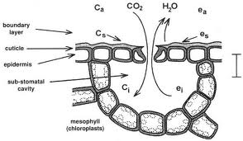
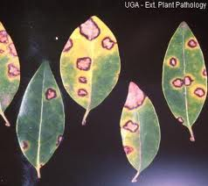
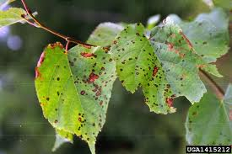
Effects of plants
Air pollution is considered to be the major factor in the decline of forests in the heavily polluted areas of the world. Air pollution affects stomata movements, photosynthesis and growth. Some adverse effects are described as below:
At high concentration of sulphur dioxide the amount of chlorophyll declines causing chlorosis of leaves. A very high concentration leads to the death of leaves.
High conc. of NO₂ leads to the development of necrotic spots
High conc. of CO leads to premature falling of leaves , smaller leaf size and curling.

Slide 37
Effects on climate
SMOG
GREEN HOUSE EFFECT AND
GLOBAL WARMING
ACID RAIN
O₃ LAYER DEPLETION

Slide 38
SMOG

Slide 39
SMOG
Smog is a combination of the words smoke and fog. It is a form of air pollution formed from the emissions from combustion reacting with sunlight to produce secondary pollutants.
A form of air pollution produced by the photochemical reaction of sunlight with hydrocarbons and nitrogen oxides that have been released into the atmosphere, especially by automotive emissions.

Slide 40
Sources of SMOG
Smog is produced by a set of complex photochemical reactions involving volatile organic compounds (VOCs), nitrogen oxides and sunlight, which form ground-level ozone. Smog-forming pollutants come from many sources such as automobile exhaust, power plants, factories and many consumer products, including paint, hair spray, charcoal starter fluid, chemical solvents, and even plastic popcorn packaging. In typical urban areas, at least half of the smog precursors come from cars, buses, trucks, and boats.

Slide 41
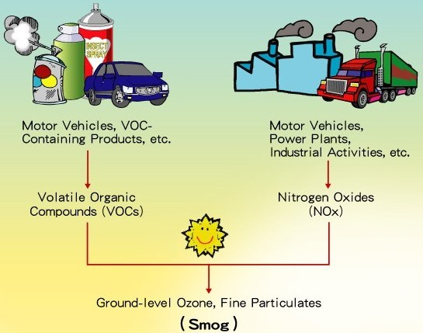

Slide 42
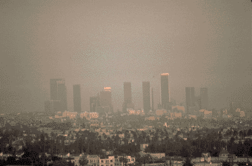
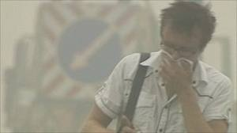
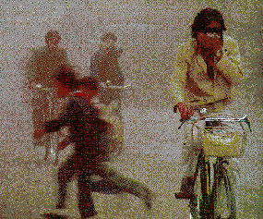
Examples of Smog

Slide 43

Combination of gases with water vapor and dust
  Combination of words smoke and fog
    Forms when heat and sunlight react gases (photochemical smog)
      Occurs often with heavy traffic, high temperatures, and calm winds

Slide 44
Its effects.....

Slide 45
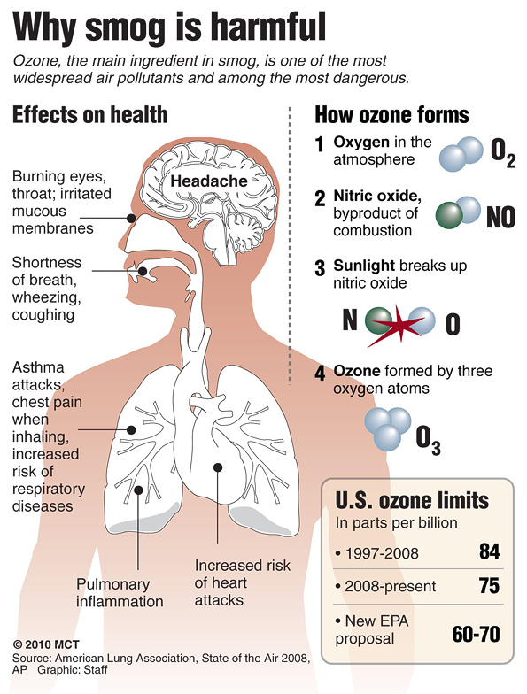

Slide 46
1st smog related deaths were in London in 1873; death toll 500 people; can you imagine how much worse the atmosphere is now?!
Limits visibility
Decreases UV radiation
Yellow/black color over cities
Causes respiratory problems and bronchial related deaths.

Slide 47
Smog creates many harmful health effects. It can cause anything from minor pain to deadly diseases such as lung cancer. Smog slowly ruins people's lungs to an extent as great as that of cigarettes.
Smog can irritate and inflame pulmonary membranes, causing chest pains, coughing, and throat irritation. Other illnesses such as colds and pneumonia can also be brought on by exposure to smog.
People with asthma problems are under an even greater threat. Even minor exposure to smog may cause these people to get asthma attacks.
Mexico City has the world's worst levels of smog. As a result, children and the elderly are advised not to live in the city. The heavy smog levels have had serious health effects in the city, though many poorer people who need city jobs have to live there and suffer from the smog.

Slide 48
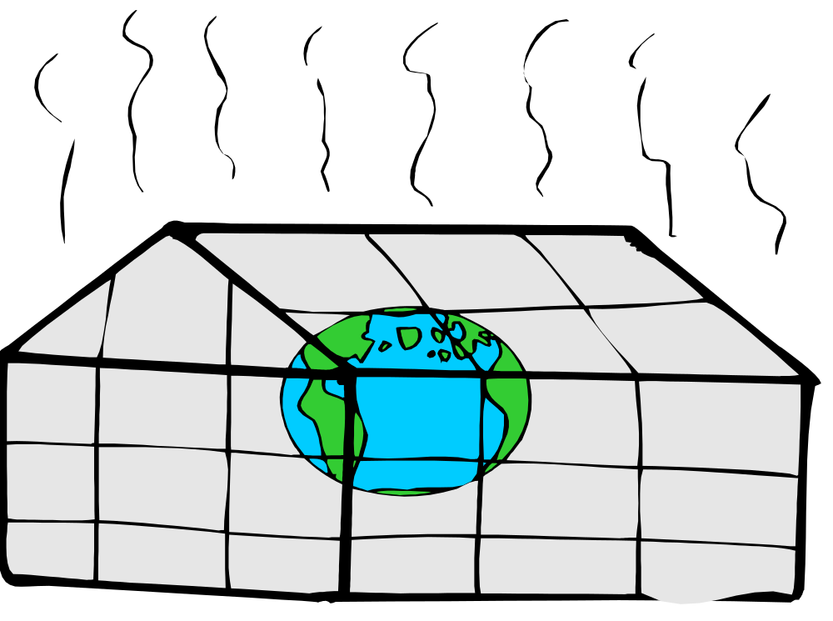
The Greenhouse Effect

Slide 49
Definition
The phenomenon whereby the earth's atmosphere traps solar radiation, caused by the presence in the atmosphere of gases such as carbon dioxide, water vapour, and methane that allow incoming sunlight to pass through but absorb heat radiated back from the earth's surface.
The heated surface then radiates some of that energy into the atmosphere in the form of longer-wavelength infrared radiation. Although some of this radiation escapes into space, much of it is absorbed by greenhouse gases in the lower atmosphere, which in turn re-radiate a portion back to the Earth's surface.

Slide 50
The atmosphere thus acts in a manner roughly analogous to the glass in a greenhouse, which allows sunlight to penetrate and warm the plants and soil but which traps most of the resulting heat energy inside. The greenhouse effect is essential to life on Earth; however, the intensification of its effect due to increased levels of greenhouse gases in the atmosphere is considered to be the main contributing factor to global warming .

Slide 51
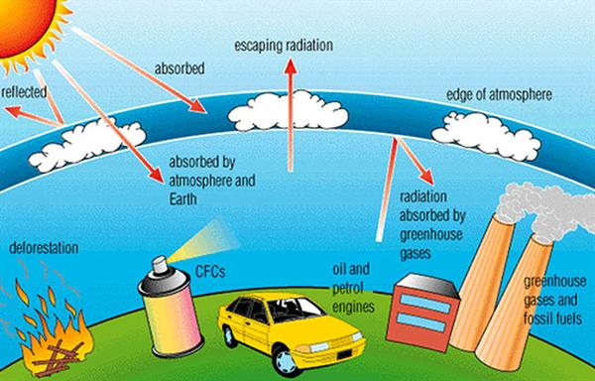

Slide 52
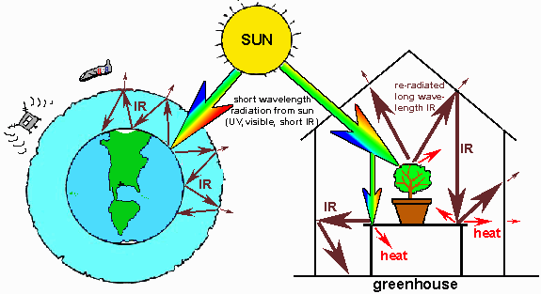
The “Greenhouse Effect”
The Earth’s surface thus receives energy from two sources: the sun & the atmosphere, As a result the Earth’s surface is ~33°C warmer than it would be without an atmosphere
Greenhouse gases are transparent to shortwave but absorb longwave radiation, Thus the atmosphere stores energy

Slide 53
Selected Greenhouse Gases
Carbon Dioxide (CO₂)
  Source: Fossil fuel burning, deforestation
  Anthropogenic increase: 30%
  Average atmospheric residence time: 500 years
Methane (CH₄)
  Source: Rice cultivation, cattle & sheep ranching, decay from landfills, mining
  Anthropogenic increase: 145%
  Average atmospheric residence time: 7-10 years
Nitrous oxide (N₂O)
  Source: Industry and agriculture (fertilizers)
  Anthropogenic increase: 15%
  Average atmospheric residence time: 140-190 years

Slide 54
Effects:
Greenhouse gases absorb infrared radiation and prevent it from escaping to space.
Carbon dioxide, methane, and nitrous oxide are very good at capturing energy at wavelengths.

Slide 55
Effects-----
The greenhouse effect‘s impact is to make life as we know it possible on planet Earth, but the greenhouse effect may also bring an end to life as we know it.
The greenhouse effect refers to the trapping of heat by certain gases in the atmosphere, including carbon dioxide and methane. Although these gases occur in only trace amounts, they block significant amounts of heat from escaping out into space, thus keeping the Earth warm enough for us to survive.

Slide 56
Effects-----
Humans have been adding greenhouse gases in excessive amounts to the atmosphere ever since the Industrial Revolution, which is enhancing the greenhouse effect and resulting in what is now known as “global warming.” This increase in greenhouse gases has the potential to cause catastrophic problems for Earth and its inhabitants.

Slide 57


Global Warming

Slide 58
Are you actually feels this
Is the world getting warmer?
If so, are the actions of mankind to blame for earth’s temperature increases?
What can/should be done about these issues?
Notes:
In examining global warming, we will be looking at questions such as 
Is the world getting warmer? 
If so, are the actions of mankind to blame for earth’s temperature increases? 
What can or should be done about global warming? 
Are the potential resolutions to global warming worth the cost to implement them? 

Slide 59
Definition
“Global warming is an average increase in the temperature of the atmosphere near the Earth’s surface and in the troposphere, which can contribute to changes in global climate patterns. Global warming can occur from a variety of causes, both natural and human induced. In common usage, “global warming” often refers to the warming that can occur as a result of increased emissions of greenhouse gases from human activities.”

Slide 60
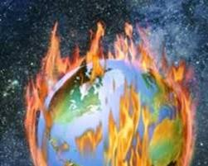
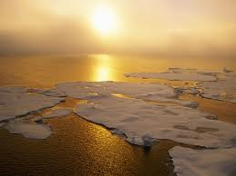
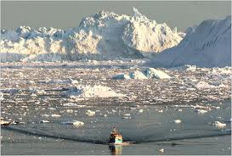

Slide 61
Causes of Global Warming
Global Warming is caused by many things. The causes are split up into two groups, man-made or anthropogenic causes, and natural causes.
Natural Causes
Natural causes are causes created by nature. One natural cause is a release of methane gas from arctic tundra and wetlands. Methane is a greenhouse gas. A greenhouse gas is a gas that traps heat in the earth's atmosphere.

Slide 62
Man-made Causes
Man-made causes probably do the most damage. There are many man-made causes.
Pollution is one of the biggest man-made problems. Pollution comes in many shapes and sizes.
Burning fossil fuels is one thing that causes pollution. Fossil fuels are fuels made of organic matter such as coal, or oil. When fossil fuels are burned they give off a green house gas called CO2.
Also mining coal and oil allows methane to escape. How does it escape? Methane is naturally in the ground. When coal or oil is mined you have to dig up the earth a little. When you dig up the fossil fuels you dig up the methane as well.

Slide 63
Causes of Global Warming
Another major man-made cause of Global Warming is population. More people means more food, and more methods of transportation, right? That means more methane because there will be more burning of fossil fuels, and more agriculture.
Another source of methane is manure. Because more food is needed we have to raise food. Animals like cows are a source of food which means more manure and methane.
Another problem with the increasing population is transportation. More people means more cars, and more cars means more pollution. Also, many people have more than one car.

Slide 64
Causes-----
Since CO2 contributes to global warming, the increase in population makes the problem worse because we breathe out CO2. Also, the trees that convert our CO2 to oxygen are being demolished because we're using the land that we cut the trees down from as property for our homes and buildings. We are not replacing the trees (an important part of our eco system), so we are constantly taking advantage of our natural resources and giving nothing back in return.

Slide 65
How to reduce Global Warming------
Global warming is the increase in the average temperature of the Earth’s near-surface air and oceans in recent decades and its projected continuation. Global warming is a very serious issue. The future would be very terrible if we don’t take any action to reduce it right away.

Slide 66
Use Public Transport:
Use Renewable Energy Like Wind Power:
Use Smart Cooler, Heater & Air Conditioner
Tune up and maintain vehicles properly
Clean the air in your house.
Reduce electricity usage to the maximum
Prefer recycling

Slide 67

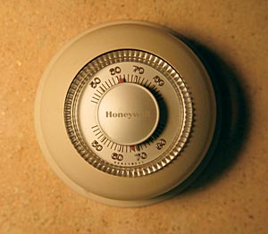




Small changes really add up
Replace your old refrigerator with a new Energy Star:
Annual savings:
$90; 700 pounds CO₂
Set your thermostat down a few degrees in the winter
Annual savings:
$135; 1400 pounds CO₂
Drive JUST 10 fewer miles per week
Annual savings:
$80; 520 pounds CO₂
Wash clothes in cold water only
Annual savings:
$70; 500 pounds CO₂
Reduce your garbage by 10% through greater recycling or reduced packaging
Annual savings:
1200 pounds CO₂
Caulk and weather-strip around doors and windows
Annual savings:
$80; 650 pounds CO₂
* These are mid-range estimates from published sources; your savings may vary.

Slide 68


Acid Rain

Slide 69
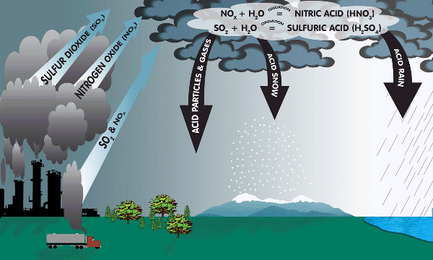
Acid Rain

Slide 70
pH of Rain
Natural Rain: Water in rain combines
with carbon dioxide to form carbonic
acid (a weak acid that causes normal
rain to be slightly acidic or below a
pH of 7)
Acid Rain: Sulfur and nitrogen
oxides from the burning of fossil
fuels combine with water in rain to
form sulfuric and nitric acids
(strong acids that cause rain to have
pH below 5.6 or be acid rain)
Notes:
Main Idea(s) of This Slide –
Students must have a general understanding of the pH scale in order to understand what acid rain really is. The following slide will show the pH scale and can be used to familiarize the students with what acids and bases are.
Natural rain form when atmospheric water molecules combine to form droplets large enough to fall to the ground. While this is happening, water molecules combine with carbon dioxide in the atmosphere to form a weak acid called carbonic acid. The carbonic acid in rain drops causes natural rain to have a pH slightly lower than 7 (a weak acid).
Two primary pollutants that cause significant acid rain will be discussed in this lessson; sulfur dioxide and nitrogen oxide. These two pollutants are released during the burning of fossil fuels (from industrial generators such as electrical power plants). When these pollutants reach the upper atmosphere, they combine with water droplets to form sulfuric and nitric acids which lowers the pH of the rain much lower than the normal pH caused by carbonic acid. Rain water with a pH of less than 5.6 is classified as acid rain.

Slide 71
Preventing acid rain
International agreements to reduce sulfur dioxide pollution.
Energy efficiency means less coal burned to make electricity.
Ultra low sulfur petrol.
Alternative energy sources like
natural gas, solar, wind farms and
nuclear.

Slide 72
Key Points to understand
When we burn fossil fuels, carbon dioxide is released into the atmosphere.
Sulfur dioxide & nitrogen oxide can be released when fossil fuels are burnt. These gases dissolve into rain (water) making it acidic. This solution then falls as acid rain.
Acid rain may damage trees directly and make rivers too acidic so plants & animals cannot live in them.
Acid rain kills organisms by stopping some enzymes from working. These enzymes control reactions & are very sensitive to pH (acid/alkaline scale).
Acid rain often falls a long way from where it was produced

Slide 73

How does Acid Rain effect us
It kills micro-organisms
It poisons plants
It damages metals and limestone
It kills fish, and other aquatic animals.
Damage buildings.
Damage plants.

Slide 74
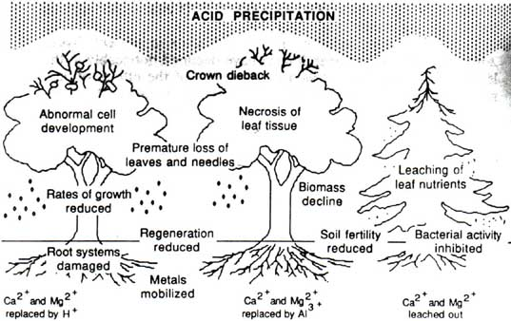
Acid Rain and Trees

Slide 75
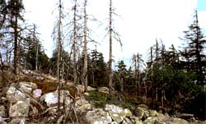
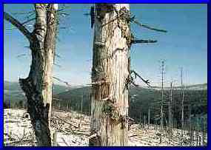

Slide 76
Control of Air Pollution
The industrial gaseous wastes should be treated from discharging them into the atmosphere.
The air quality can be improved and maintained by growing and developing green belts and forests.
Instead of using low grade and conventional fuels, non-conventional fuels like goober gas, LPG, natural gas, must be prepared and used.
The vehicular pollution can be controlled by using good quality fuel by keeping the engine fully effective and by minimizing the use of motored vehicles.

Slide 77
Water Pollution
The addition of various organic and inorganic substances changes the physical and chemical properties of water and thereby causes adverse effects on life and water usability.
In a simple sense, water pollution is the adding to water of any substance, or the changing of water's physical and chemical characteristics in any way which interferes with its use for legitimate purposes.

Slide 78
Causes of Water Pollution
Natural causes
Soil eroded by rains
Dead and decay of vegetation and dead organisms
High speed winds
Floods
Man made causes
Sewage and other wastes
Industrial waste
Agricultural waste
Human activities
Customs and traditions

Slide 79
Effects of water pollution
Adverse effects on human health
Loss of aquatic biodiversity
Disruption of aquatic ecosystem
Loss of scenic beauty

Slide 80
Control of Water Pollution
Industrial waste should be treated before it is discharged into the pond or lake.
Paper, plastic, food material etc. should not be thrown in rivers.
Human activities like bathing and washing must be stopped.
The laws of pollution should be implemented strictly.
Washing of trucks, tractors and other heavy vehicles in the water bodies should not be allowed.
Use of harmful chemicals such as pesticides and fertilizers must be controlled in agriculture

Slide 81

Noise pollution
The unwanted noise dumped into the atmosphere that leads to discomfort and health hazards is known as noise pollution.

Slide 82
Causes of Noise Pollution
Natural causes
Chirping of birds
Thunder and lightening
Storms
Rainfall
Exchanging voices of living organs including man and animals
Man made causes
Domestic appliances
Industries
Transportation
Entertainment
Community functions
Agricultural operations
Crowded markets

Slide 83
Effects of Noise Pollution
Auditory Effects
Non Auditory Effects

Slide 84
Control of Noise Pollution
The workers should be provided with ear plugs and ear muffs to minimize their health related problems.
The vehicular noise can be reduced by keeping the engine clean.
Industrial noise can be reduced by keeping the machines well serviced and making special glass or wooden cabins for such machines.
Designing silencing devices in aircraft engines.
By planting trees which are effective sound absorbers.
Creating public awareness

Slide 85
Soil pollution
Any change in the physical chemical and biological properties of soil due to natural or man-made activities is known as soil pollution.

Slide 86

Causes of Soil Pollution
Industrial waste
Urban waste
Mining
Agricultural waste
Domestic waste and garbage
Radioactive wastes

Slide 87
Effects of Soil Pollution
Reducing the fertility of the soil and degrading the quality of land.
Increase in the the growth of a number of mosquitoes, flies which cause diseases in human beings .
Loss of soil microorganisms
Water Pollution
Causing diverse health effects such as cancer, deformities in bones, etc in human beings .
Loss of aesthetic value of land.

Slide 88
Control of Soil Pollution
The industrial waste must be treated in the proper treatment plants and then allowed to be discharged through the proper drains.
The city garbage must be properly separated so that the bio-degradable waste may be used to make fertilizers.
Soil can be conserved by planting trees like mango, neem, etc. around the fields so that their leaves continuously supply the nutrients to the soil.
The release of radioactive materials in the soil should be minimized. Activities such as nuclear testing should be prohibited.
Paper, glass, tin, iron, etc. present in solid waste should be reused after recycling.
Solid waste can also be used for electricity generation.
Use of chemical fertilizers and toxic chemicals should be minimized as far as possible.

Slide 89
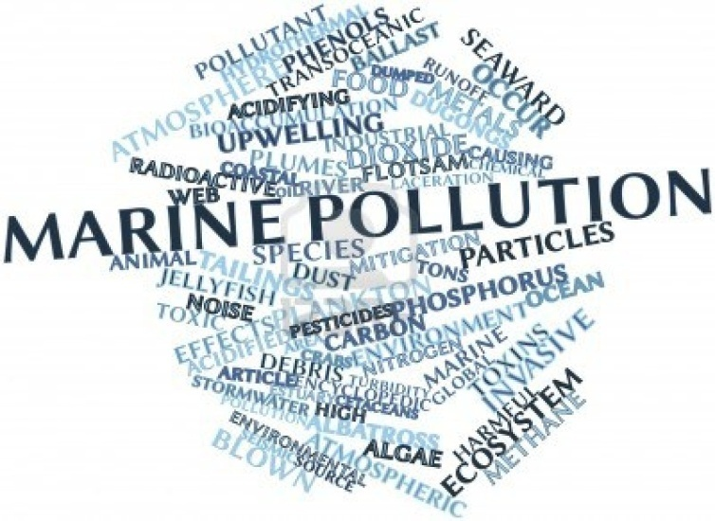
Marine pollution
Marine pollution occurs when harmful, or potentially harmful effects, can result from the entry into the ocean of chemicals, particles, industrial, agricultural and residential waste, noise, or the spread of invasive organisms.

Slide 90
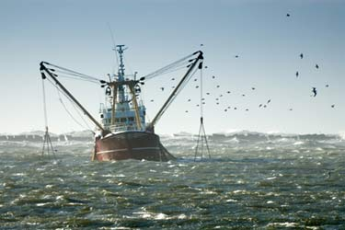
What causes Marine Pollution ?
Oil and Petroleum
Toxic chemicals
Hazardous wastes
Raw sewage
Thermal pollution.

Slide 91
Effects of Marine Pollution
Reduction in photosynthetic rate
Decline in dissolved oxygen
Toxicity
Eutrophication
Diseases
Effect on marine animals

Slide 92
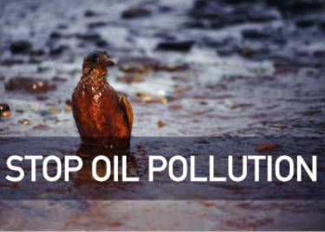
Control of marine pollution
Control of oil pollution by the use of certain chemicals, microbes and
antifouling paints.
Hot water discharged from thermal power plants should be mixed with
ordinary water (nutrient rich) and be used for aqua-culture.
Recycling of solid waste such as plastic, glass, metal, papers, etc.
Sewage and factory wastes should be treated before releasing into
seawater.
Establishment of marine protected areas, bioregional management
approach and negotiation of international agreements.
Maintenance and proper security of ships

Slide 93
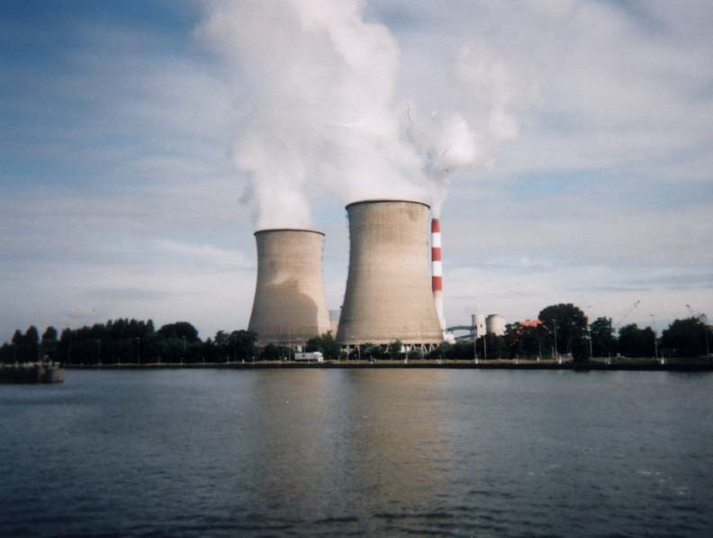
Thermal pollution
Chemical industries, fossil fuel and nuclear power plants use water for cooling purpose
and return this water to stream at higher temperature. The rise in water temperature
due to warm water discharged after cooling the machines in factories and in nuclear
and thermal power plants is called thermal pollution.

Slide 94
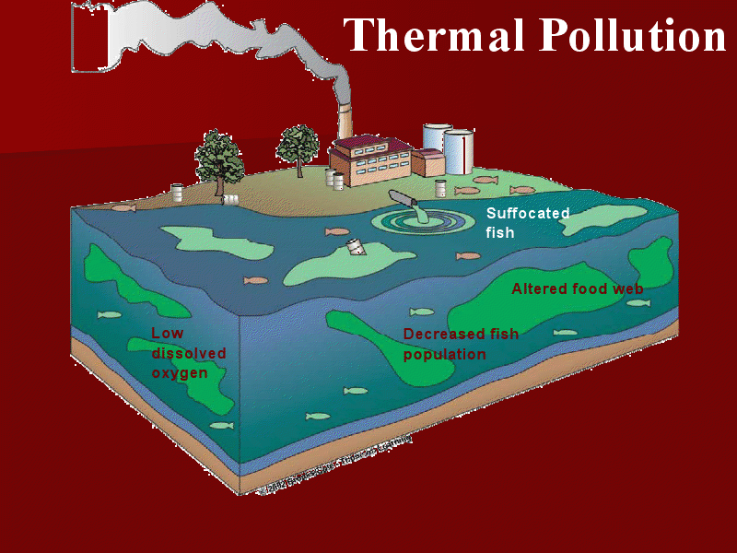
Effects of Thermal Pollution
Change in the physical and chemical properties of water.
Decreases in the concentration of dissolved oxygen in water making it unsuitable for the survival of aquatic life.
Decline in microbial population
Reduction in the productivity of aquatic ecosystems.

Slide 95
Control of Thermal Pollution
Establishment of cooling towers.
Constructing ponds for collecting hot water.
Artificial lakes can be made for the hot effluents from where the cool water can be recycled.
The cold water or air showers may be used in the industries to check hot gases, at the source.

Slide 96


Radiation pollution-nuclear hazards
Among the hazardous substances radioactive materials are most damaging. In nuclear reactors uranium, plutonium, etc. are used as fuel. The remains of such reactions are called nuclear waste and this type of pollution is called radioactive pollution.

Slide 97
Causes of Radioactive or Radiation Pollution
Natural causes
Cosmic rays are high-energy protons and electrons that are released from sun.
Environmental sources – Soil, rock, air ,etc.
Man made causes
Radioactive waste from nuclear power plants
Nuclear explosions
Medical use
Radiations from luminous watches, clock dials, X-rays from microwave, etc. constitute the
miscellaneous sources of exposure.

Slide 98

Effects of Radiation Pollution
Somatic Effects
Genetic Effects

Slide 99
Control Measures of Radioactive Pollution
Plantation of dense trees around the atomic power plants.
Proper management of radioactive waste.
Unnecessary X-ray examination should be avoided.
Suitable waste disposal methods and better technology for nuclear power plants should be developed to protect against radiation health hazards.
During nuclear installations, various efforts including the process of site selection, its design, construction, operation, and its short and long term effects should be seriously considered to control radiation.

Slide 100
Solid Waste Management (SWM)
What is solid waste ?
Solid waste is the unwanted or useless solid materials generated from combined
residential, industrial and commercial activities in a given area.
Why Management ??
Management of solid waste reduces or eliminates adverse impacts on the environment
and human health and supports economic development and improved quality of life.

Slide 101

From where does waste come from ?
Domestic garbage
Industrial waste
Commercial waste
Mining waste.
Radioactive waste
Agricultural waste
Hospital waste

Slide 102
Effect of Urban and Industrial Solid Waste
Increase in the population of disease causing organisms such as mosquitoes, flies, etc.
Water pollution
Air pollution
Diseases in human beings
Reducing the aesthetic value of land

Slide 103





Waste Disposal Methods
Open Dumping
Land Fill
Incineration
Ocean Dumping
Composting

Slide 104
Role of an individual in prevention of environmental pollution
Less use of non renewable energy sources.
Plantation of more and more trees.
Minimizing the use of insecticides, pesticides and chemical fertilizers in agriculture.
Conservation of natural resources
Promote environmental awareness and actively participating in public hearing on environmental issues.
By keeping the city and surroundings clean.
By using paper and cloth bags instead of using polythene bags
Adopt and popularize renewable energy resources

